Slide 1




C.A.R.E Breast Cancer Prediction Tool
C.A.R.E
User ID
Password
☐ Remember Me
Login
Register
Forgot User ID or password?
Need Help?

Slide 2






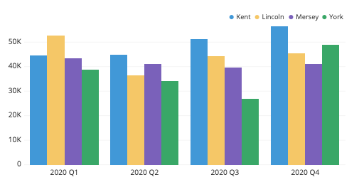
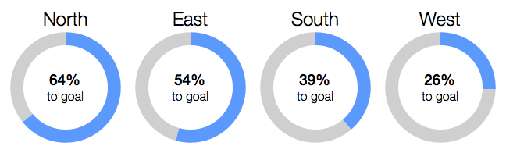
C.A.R.E Breast Cancer Prediction Tool
Home
Search
Profile
Help
Logout
Summary Dashboard
Total Patients
Survival Rate
Average Cost
Something
10,123
72%
$10,000
10%
Dr. Lim Xiao Ming
Treatment Expenditure by Stage
Survival Rate by Stage
Dashboard
Stage 1
Stage 2
Prediction
Stage 3
Stage 4

Slide 3
C.A.R.E Breast Cancer Prediction Tool
Home
Search
Profile
Help
Logout
Prediction
New Patient
Existing Patients
Dr. Lim Xiao Ming
Dashboard
Prediction

Slide 4


C.A.R.E Breast Cancer Prediction Tool
Home
Search
Profile
Help
Logout
>
New Patient
Enter Patient’s ID:
Retrieve
Manual Entry
Retrieve from Database
Back

Slide 5
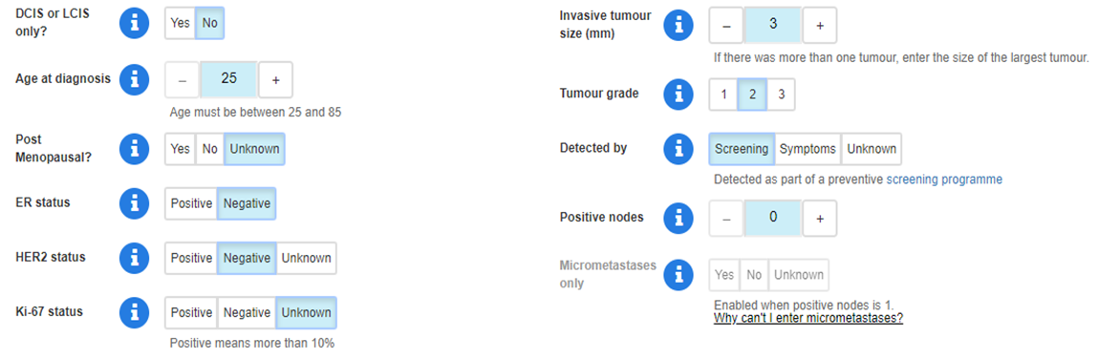
C.A.R.E Breast Cancer Prediction Tool
Home
Search
Profile
Help
Logout
>
New Patient
Enter Patient’s ID:
Retrieve
Manual Entry
Back
Go

Slide 6
C.A.R.E Breast Cancer Prediction Tool
Home
Search
Profile
Help
Logout
>
Existing Patients
Enter Patient’s ID:
Go
A
M
Z
Angela Lim
Ang Xiao Ling
August Tan
Mary Lim
May Tan
Marie Ong
Maria Goh
Zhang Xiao Ming
B
Back

Slide 7

C.A.R.E Breast Cancer Prediction Tool
Home
Search
Profile
Help
Logout
>
Prediction
Survival
Cost
Jean Tan
Age: 33
Gender: Female
Age Diagnosed:
Diagnosis:
Affected Area:
Notes:
More

Slide 8
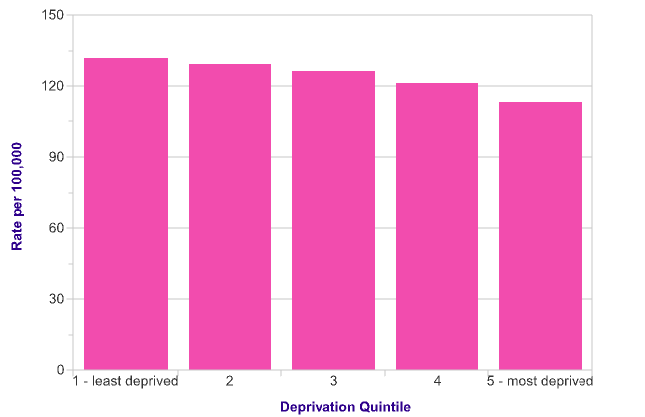
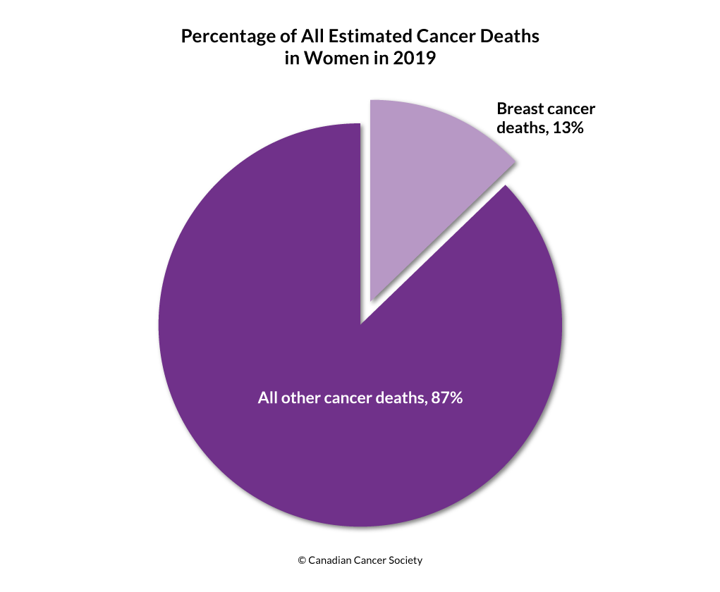

C.A.R.E Breast Cancer Prediction Tool
Home
Search
Profile
Help
Logout
Survival Prediction
Patient View
Doctor View
Dr. Lim Xiao Ming
Dashboard
Prediction
Survival
Cost
*Prediction accurate as at 20 December 2019

Slide 9
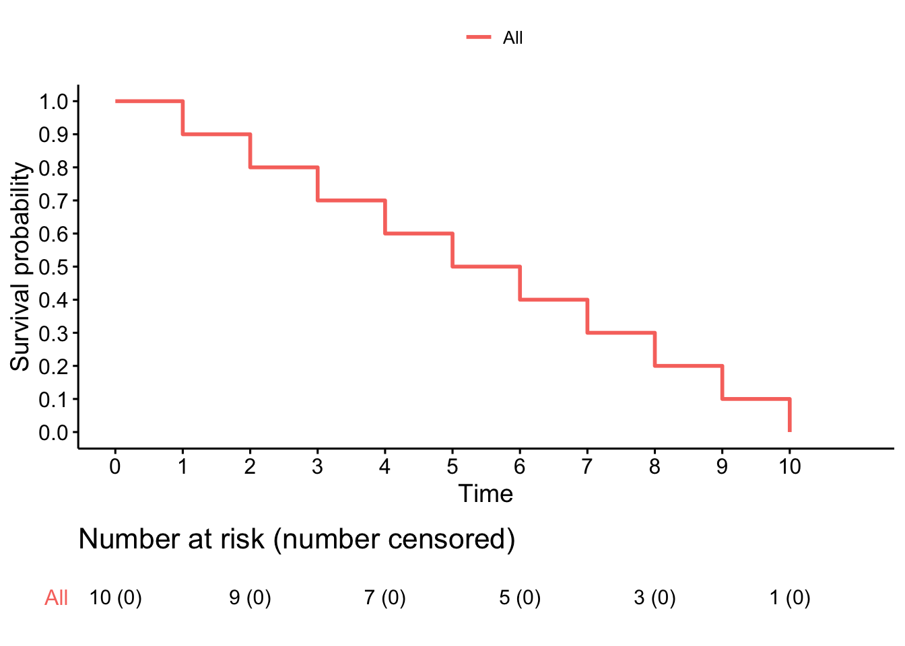
C.A.R.E Breast Cancer Prediction Tool
Home
Search
Profile
Help
Logout
>
Survival Prediction
Patient View
Doctor View
Filters
Predicted Survival Rate:
80%
*Prediction accurate as at 20 December 2019

Slide 10
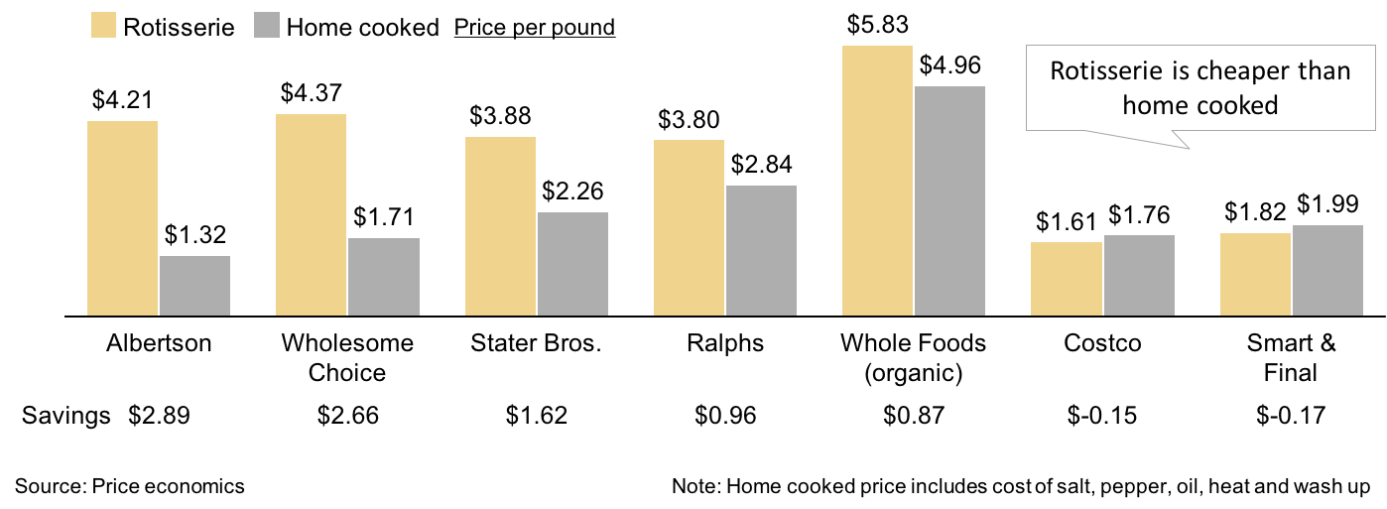
C.A.R.E Breast Cancer Prediction Tool
Home
Search
Profile
Help
Logout
>
Cost Prediction
Filters
Estimated Cost:
$10,000
*Prediction accurate as at 20 December 2019

